Slide 1

SMART INDIA HACKATHON 2026
TITLE PAGE
Problem Statement ID –SIH26188
Problem Statement Title- AI-Based Fake Identity & Document Screening System
Theme- Miscellaneous
PS Category- Software
Team ID-
Team Name- Zentrix

Slide 2
AI-Based Fake Identity & Document
Screening System
Zentrix
Problem:
Idea:
Fake, altered, and misused identity documents are becoming increasingly difficult to identify through manual verification. Manual checking is time-consuming, error-prone, and may fail to detect sophisticated document manipulation or identity misuse.
An AI-based screening system that performs multi-layer verification using OCR, document image analysis, face verification, and data consistency checks to identify suspicious documents and possible identity misuse.
Proposed Solution :
AI-Based Document Checking: Uses OCR and AI to extract and verify important details from identity documents.
Fake & Tampering Detection: Detects edited text, changed photos, unusual patterns, and other signs of document manipulation.
Face Verification: Compares the face on the document with the user's face to identify possible identity misuse.
Risk Score & Report: Combines all checks to generate a risk score and clearly explains whether the document is safe, suspicious, or high-risk.
Innovation / Uniqueness:
Multi-Level AI Verification: Combines OCR, document checking, face matching, and image analysis for better accuracy.
Smart Tampering Detection: Identifies edited text, replaced photos, and other suspicious changes in documents.
AI-Based Risk Score: Combines all verification results to classify documents as Safe, Suspicious, or High Risk.
Explainable Results: Clearly shows why a document or identity is flagged, helping authorized users make better decisions.

Slide 3
TECHNICAL APPROACH
Zentrix
Technologies :
Programming: Python, JavaScript, SQL
Frontend: React.js
Backend: FastAPI
AI/ML: TensorFlow
OCR: Tesseract
Image Processing: OpenCV
Face Verification: FaceNet
Database: MySQL
Deployment: Docker + Cloud Platform
Hardware: Laptop/PC with camera for prototype testing
Flowchart:
INPUT & COLLECTION
Upload the identity document + selfie/live image for verification.
OCR & INFORMATION EXTRACTION
Extract key details such as Name, DOB, ID Number, and Expiry Date from the document.
AI-BASED DOCUMENT ANALYSIS
Analyze the document to detect tampering, altered information, photo replacement, and suspicious patterns.
RISK ASSESSMENT & REPORT
Generate an AI-based risk score and provide a clear result: Verified / Review / High Risk, with reason
IDENTITY & DATA VERIFICATION
Match the document photo with the user's face and check the extracted information for consistency.

Slide 4
FEASIBILITY AND VIABILITY
Zentrix
Analysis of the Feasibility of the Idea:
Technically Feasible: Uses existing AI technologies such as OCR, computer vision, and face verification.
Easy to Implement: Can be developed using Python, React.js, FastAPI, OpenCV, and pre-trained AI models.
Scalable: The system can be extended to different types of identity documents and verification environments.
Practical Impact: Reduces manual verification time and helps identify document fraud and impersonation.
Potential Challenges & Risks:
Poor Image Quality: Blurry, damaged, or low-light documents may reduce detection accuracy.
Advanced Forgery: Sophisticated edits or AI-generated documents may be difficult to detect.
Face Matching Errors: Different lighting, camera quality, or facial changes can affect verification.
Data Privacy: Identity documents and facial data are highly sensitive and must be handled securely.
Strategies to Overcome Challenges:
Image Preprocessing: Improve document quality using OpenCV before analysis.
Multi-Level Verification: Combine OCR, tampering detection, face matching, and data consistency checks instead of relying on one method.
AI Model Improvement: Test with diverse genuine and forged documents and continuously improve the models.
Secure Data Handling: Use encryption, access control, and minimal data storage to protect user information.

Slide 5
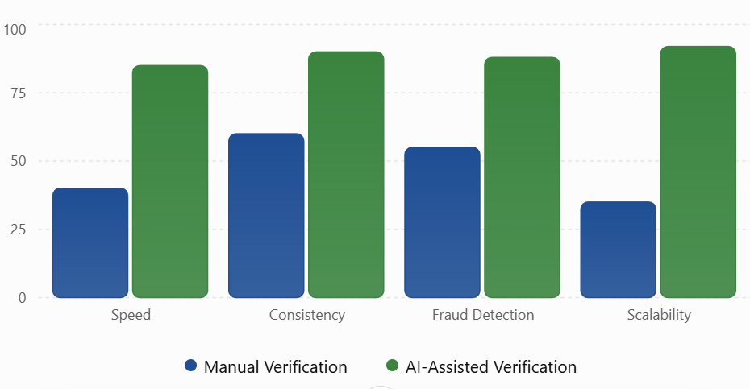
IMPACT AND BENEFITS
Zentrix
Target Users & Use Cases:
Government & Public Services:Faster preliminary identity screening and reduced fraudulent registrations.
Banks & Financial Institutions:Supports detection of fake IDs and identity misuse during onboarding and verification.
Educational Institutions & Organizations:Supports identity verification during admissions and recruitment.
Digital Services & KYC:Enables faster automated screening during identity-based onboarding.
Strategic Impact:
Provides multi-layer AI verification against forged documents, tampering, and identity impersonation.
Reduces dependence on slow and error-prone manual verification.
Strengthens India's digital identity security by enabling scalable, AI-driven fraud detection.
Supports secure and trustworthy digital services across government and private sectors.
Economic & Social Benefits:
Reduces verification time and operational costs through automated screening.
Helps prevent financial losses caused by identity fraud and document forgery.
Protects citizens from identity theft and impersonation.
Promotes paperless, faster, and scalable digital verification, contributing to a safer digital India.

Slide 6
RESEARCH AND REFERENCES
Zentrix
Research & Reference Work:
1. NIST – Digital Identity Guidelines: Identity Proofing & Enrollment
Defines how identity evidence is validated and verified to establish a person’s identity.
NIST SP 800-63A-4
2. NIST – Face Recognition Technology Evaluation (FRTE):
Evaluates face-verification systems using False Match Rate (FMR) and False Non-Match Rate (FNMR).
NIST Face Recognition Technology Evaluation
3. FATF – Guidance on Digital Identity:
Provides guidance on reliable digital identity verification, supporting the use of multiple verification layers.
FATF – Guidance on Digital Identity
4. Tesseract OCR Documentation:
Tesseract enables automatic text extraction from identity documents, such as Name, DOB, ID Number, and Expiry Date.
Tesseract OCR Documentation

